Slide 1

Map, filter

Slide 2
Recap
More about functions
How do we make a simple grid
Discussed all things that were unclear

Slide 3
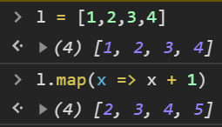
Example map
What is a Map function?
Similair to foreach
Implemented function in most languages

Slide 4
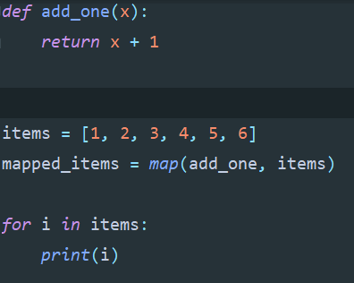
Example map
What is a Map function?
Similair to foreach
Implemented function in most languages

Slide 5
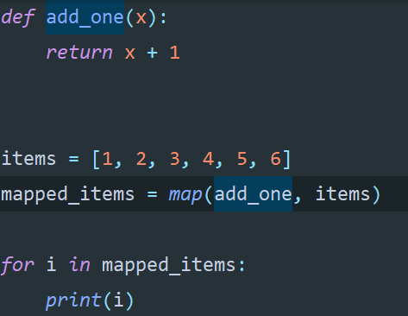
Example map

Slide 6
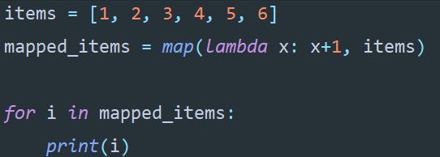
Example map

Slide 7
Exercise
Create a array of strings
Create a function that takes one parameter and adds a “!” to it
Use the map function with the created array and function to add “!” to all items

Slide 8
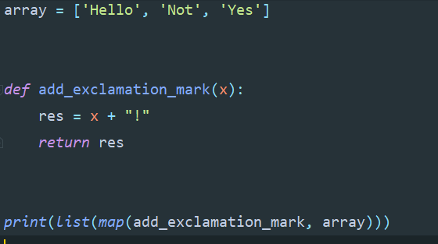
Exercise
Create a array of strings
Create a function that takes one parameter and adds a “!” to it
Use the map function with the created array and function to add “!” to all items

Slide 9
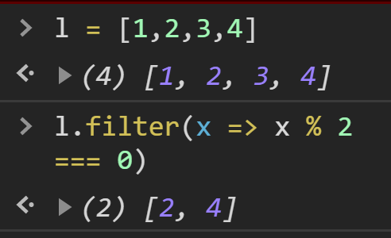
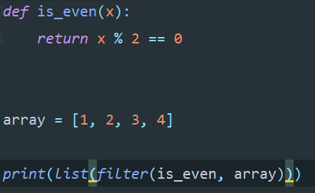
Example filter

Slide 10
Example filter
What should a function used in a filter return?

Slide 11
Example filter
What should a function used in a filter return?
A boolean
Because it checks each item if it is in the right condition (if statement)

Slide 12
Exercise
Create a array of strings
Create a function that takes one parameter and checks if the string contains a certain char.
Use the filter function with the created array and function to filter the items on a certain char.

Slide 13
Summary
Map
Filter

